Slide 1

Biometrics:
Fingerprint Technology

Slide 2
Agenda
Why Biometrics?
Fingerprint Patterns
Advanced Minutiae Based Algorithm
Identification vs. Authentication
Security
Applications
Versus other Biometric Technologies
Industry

Slide 3
Why Biometrics?

Slide 4
Why Biometrics?
Biometrics is a security solution based on something you know, have, and are:
Know | Password, PIN
Have | Key, Smart Card
Are | Fingerprint, Face, Iris

Slide 5
Why Biometrics?
Passwords are not reliable.
  Too many
  Can be stolen
  Forgotten
Protect Sensitive Information
  Banking
  Medical

Slide 6
Why Biometrics?
Has been used since 14th century in China
  Reliable and trusted
Will never leave at home
Fingerprints are unique
  Everyone is born with one
80% of public has biometric recorded

Slide 7
Fingerprint Patterns

Slide 8
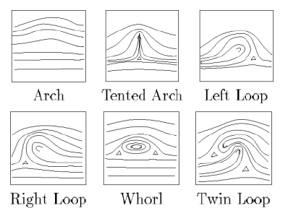
Fingerprint Patterns
6 classes of patterns

Slide 9
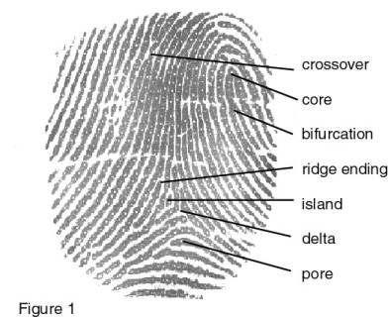
Fingerprint Patterns
Minutiae
  Crossover: two ridges cross each other
  Core: center
  Bifurcation: ridge separates
  Ridge ending: end point
  Island: small ridge b/w 2 spaces
  Delta: space between ridges
  Pore: human pore

Slide 10
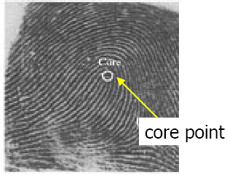
Fingerprint Patterns

Slide 11
Fingerprint Patterns
Two main technologies used to capture image of the fingerprint
  Optical – use light refracted through a prism
  Capacitive-based – detect voltage changes in skin between ridges and valleys

Slide 12
Advanced Minutiae Based Algorithm (AMBA)

Slide 13
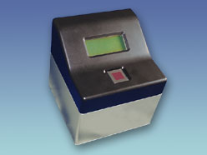
Advanced Minutiae Based Algo
Advanced Minutiae Based Algorithm
  Developed by Suprema Solutions
  Two processes
    Feature Extractor
    Matcher

Slide 14
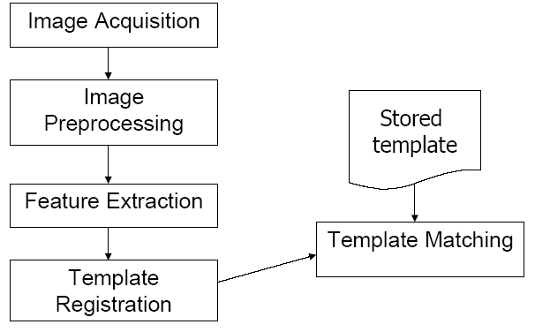
Advanced Minutiae Based Algorithm

Slide 15
Advanced Minutiae Based Algo
Feature Extractor
  Core of fingerprint technology
  Capture and enhance image
  Remove noise by using noise reduction algorithm
  Processes image and determines minutiae
    Most common are ridge endings and points of bifurcation
    30-60 minutia

Slide 16
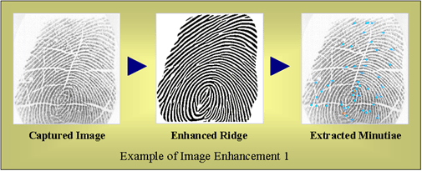
Advanced Minutiae Based Algo
Feature Extractor
  Capture Image
  Enhance Ridge
  Extract Minutiae

Slide 17
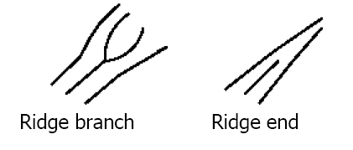
Advanced Minutiae Based Algo
Feature Extractor
  Most frequently used minutiae in applications
    Points of bifurcation
    Ridge endings

Slide 18
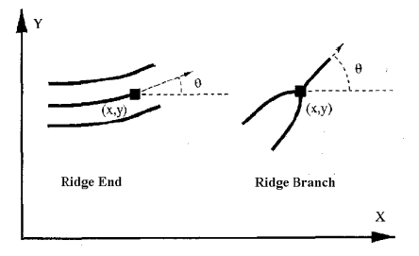
Advanced Minutiae Based Algo
Feature Extractor
  Minutiae Coordinate and Angle are calculated
  Core is used as center of reference (0,0)

Slide 19
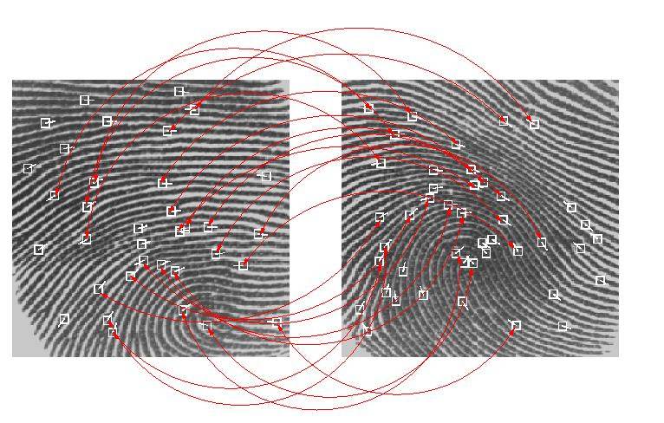
Advanced Minutiae Based Algo
Matcher
  Used to match fingerprint
  Trade-off between speed and performance
  Group minutiae and categorize by type
    Large number of certain type can result in faster searches

Slide 20
Identification vs. Authentication
Identification – Who are you?
  1 : N comparison
  Slower
  Scan all templates in database
Authentication – Are you John Smith?
  1 : 1 comparison
  Faster
  Scan one template

Slide 21
Security
Accuracy
  97% will return correct results
  100% deny intruders
Image
  Minutiae is retrieved and template created
    Encrypted data
  Image is discarded
    Cannot reconstruct the fingerprint from data

Slide 22
Security
Several sensors to detect fake fingerprints
  Cannot steal from previous user
    Latent print residue (will be ignored)
  Cannot use cut off finger
    Temperature
    Pulse
    Heartbeat sensors
    Blood flow

Slide 23
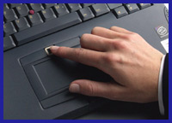
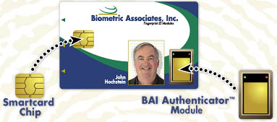
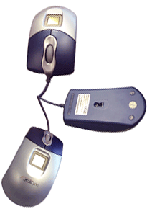
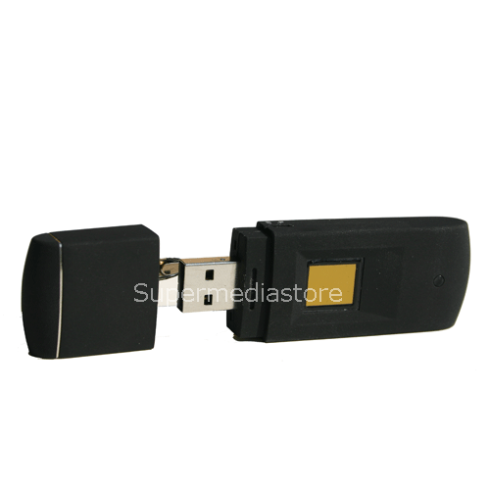
Applications

Slide 24
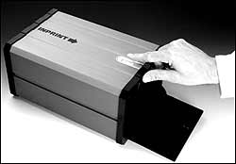
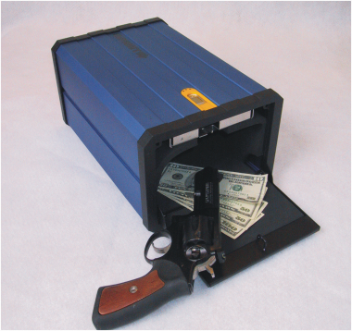
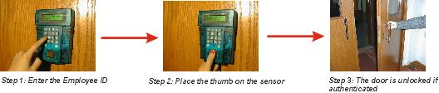
Applications

Slide 25
Versus other Biometric Technologies
1 (worst) – 5 (best)
Technology | Accuracy | Convenience | Cost | Size
Fingerprint | 5 | 5 | 4 | 4
Voice | 1 | 5 | 5 | 5
Face | 2 | 3 | 4 | 3
Hand | 3 | 3 | 2 | 2
Iris | 5 | 2 | 3 | 3

Slide 26
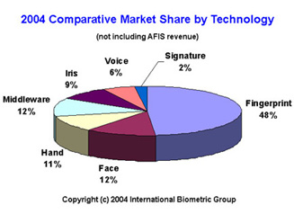
Versus other Biometric Technologies

Slide 27
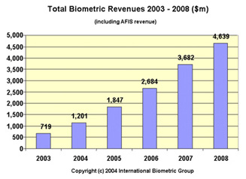
Industry
Hot market
Lots of $$$

Slide 28
Conclusion
Want to protect information
Passwords are not reliable; forget
Fingerprints have been used for centuries
Fingerprints are unique; can verify
Very accurate
Lots of applications being developed
Hot market. Lots of $$$

Slide 29
Biometrics:
Fingerprint Technology
THE END!

